Slide 1

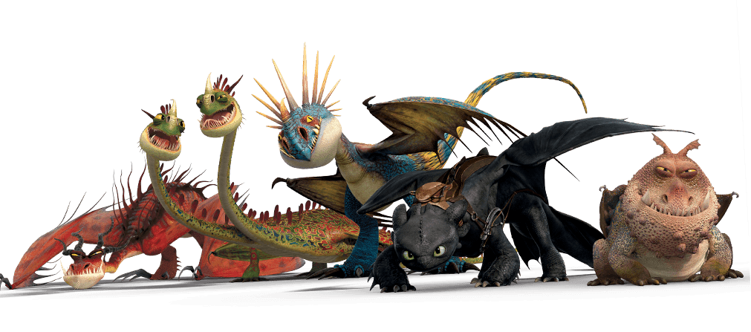
How to Train Your Pet Computer MESA Bootcamp 2023: Raglan
October 2023
Notes:
https://www.pngwing.com/en/search?q=how+To+Train+Your+Dragon+2
https://www.pngwing.com/en/free-png-hmpln/download

Slide 2
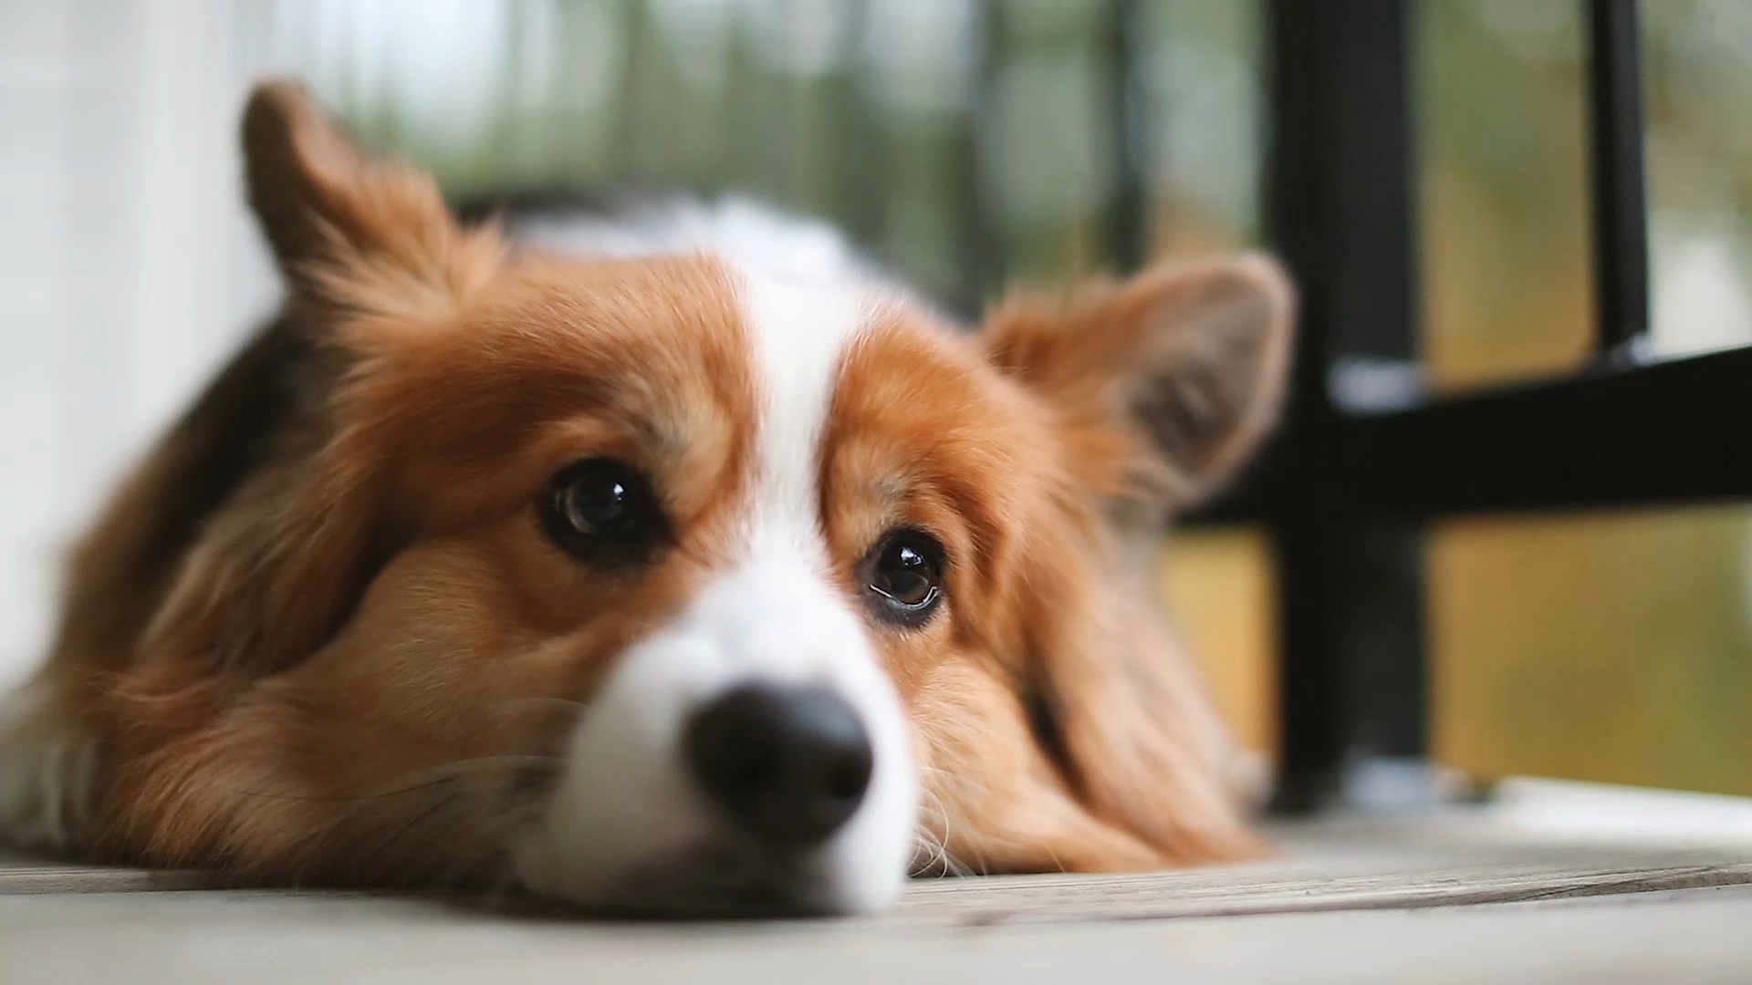
How to Train Your Pet Computer MESA Bootcamp 2023: Raglan

Slide 3
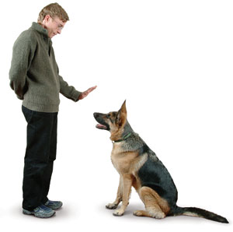
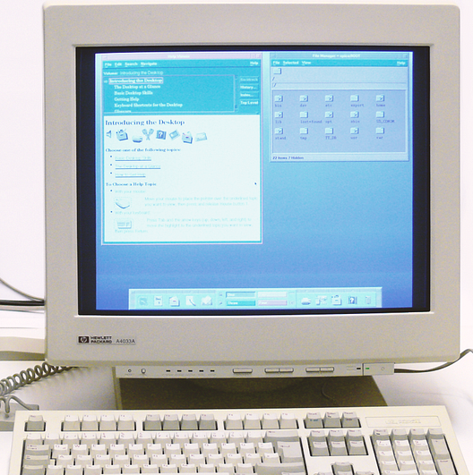
Sit.
Good Boy
11100101
I mean
Woof

Slide 4
Goals of Today’s Workshop
1
2
3
Learn ML
Scikit-Learn
Applications
Main Goals:
Gain some hands-on experience in machine learning
Understand what you do when you are designing a ML program
Giving you somewhere to start to learn more on your own after bootcamp.
Learn some fundamental concepts about Machine Learning
Get some hands on experience with Machine Learning using Scikit-Learn
Apply our new skills to a real-world application

Slide 5
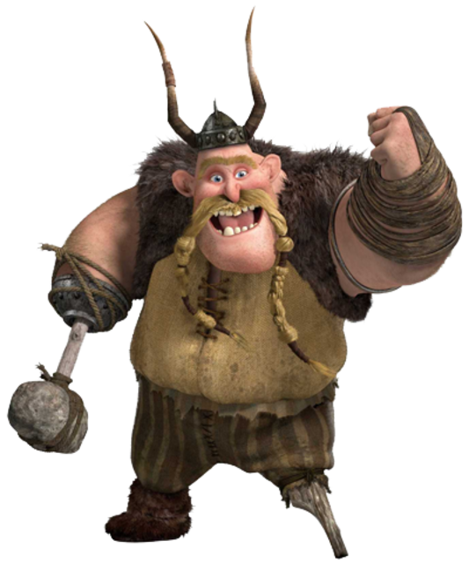
Outline of this Workshop
12:00pm – 1:30pm
Part 1: General Introduction to Machine Learning
Part 2: Supervised Learning
Part 3: Unsupervised Learning
1:30pm – 2:00 pm
Break
2:00pm – 3:30pm
Part 3: Unsupervised Learning (Continued)
Part 4: Applying ML to real-world data

Slide 6

Part 1: INTRODUCTION
What is Machine Learning?

Slide 7
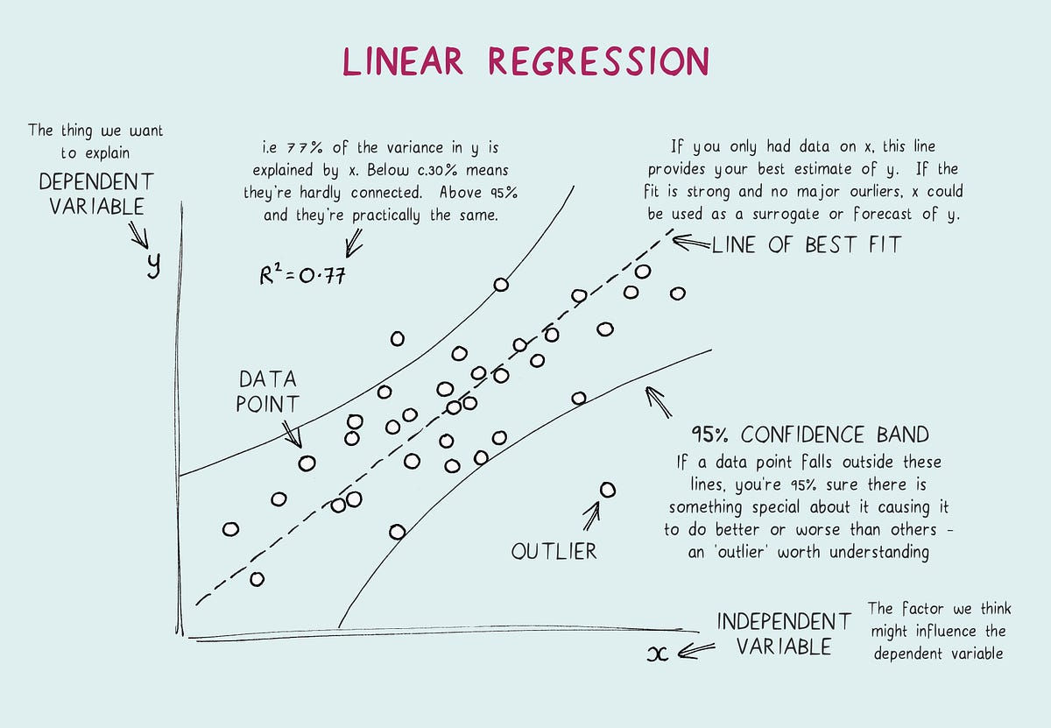
What is Machine Learning?
It’s a lot of things:
Fundamentally statistics, with a bit extra:
Machine learning is about finding generalizable predictive patterns in systems using past data about the system.
Based on statistics, mathematics, information theory, natural science, and so much more!
Example of machine learning you have all done, plotting data!
In machine learning, this is called regression.
In linear regression, we plot a linear line of best fit to understand data and predict the dependent variable (y) based on a given independent variable (x).
The new machine learning algorithms we will learn today deal with data that contain trends that can not be easily predicted using regression methods.
Linear Regression.jpeg
Reference: https://towardsdatascience.com/linear-regression-explained-1b36f97b7572

Slide 8
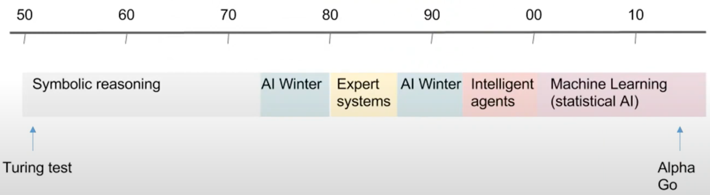
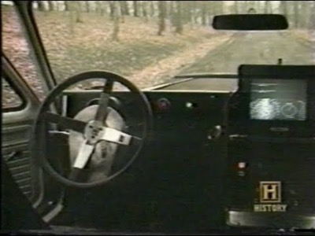
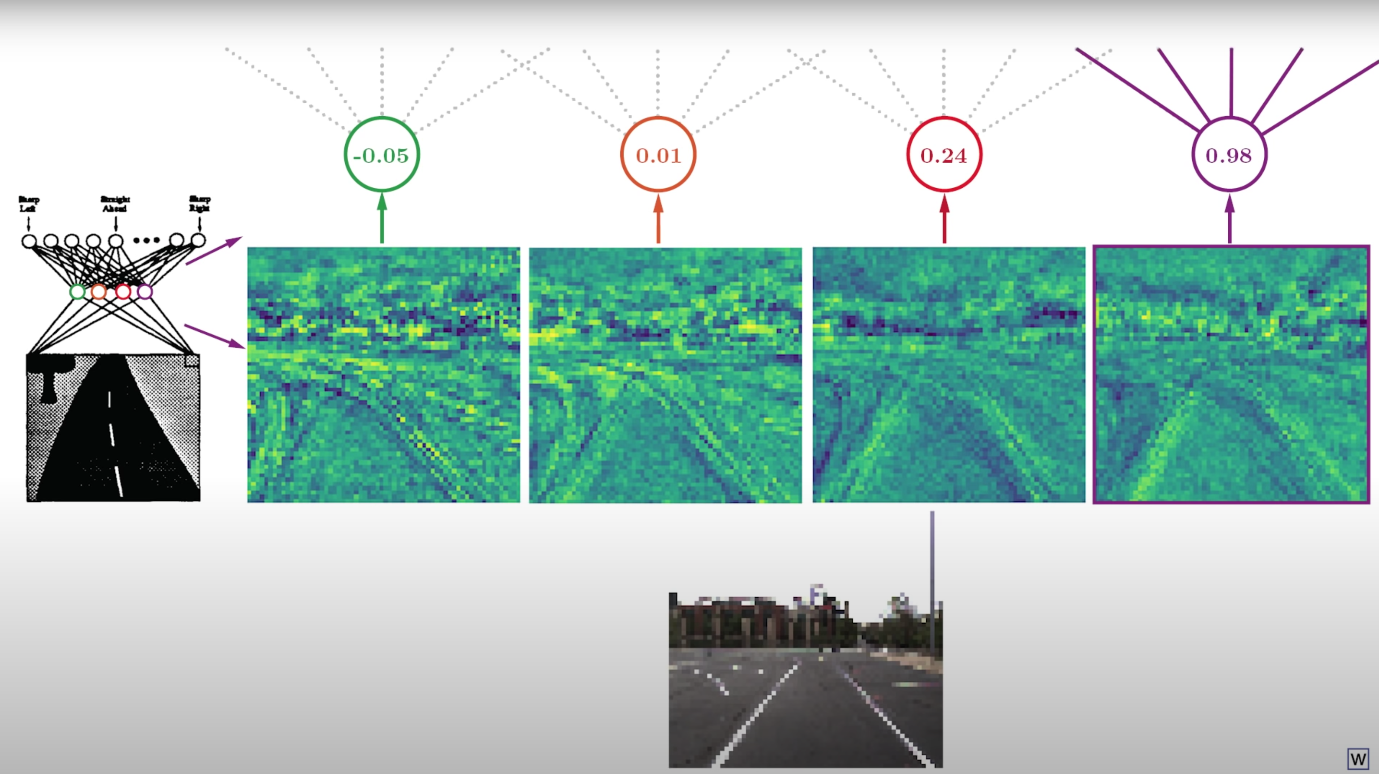
ML has been around for a while
Three Renaissances of Artificial Intelligence:
1940’s – 1960’s: Beginning to formulate ideas
Neural networks had been devised in this time
1980’s: Computer technology improved → Microcomputers
Development in ML algorithms
ML Companies began to form; however, these companies could not deliver on their promises.
2000’s to Today: Scientific method and Statistics implemented
Allowed ML systems to be rigorously tested and algorithms began to self-correct themselves when things went wrong.
AI History.png
Self Driving Car 1980’s.mp4
Self Driving Car Neural Network.exe
Reference: https://towardsdatascience.com/linear-regression-explained-1b36f97b7572
Notes:
https://youtu.be/H0igiP6Hg1k

Slide 9
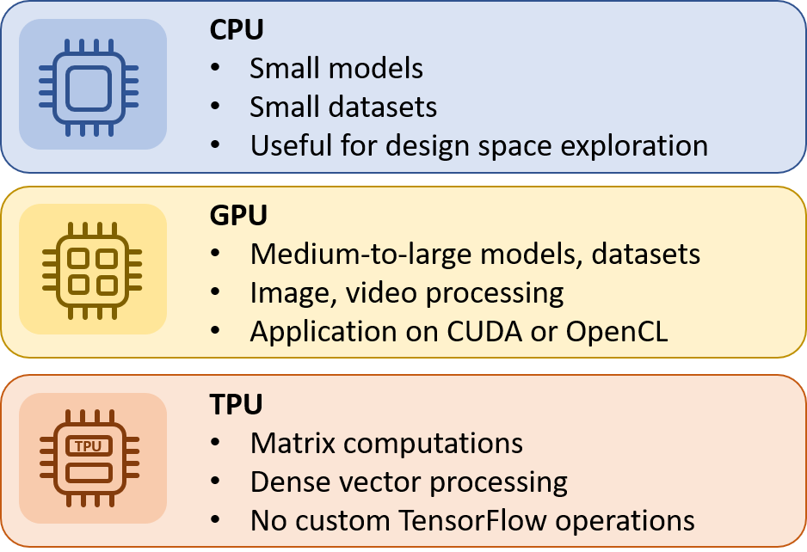
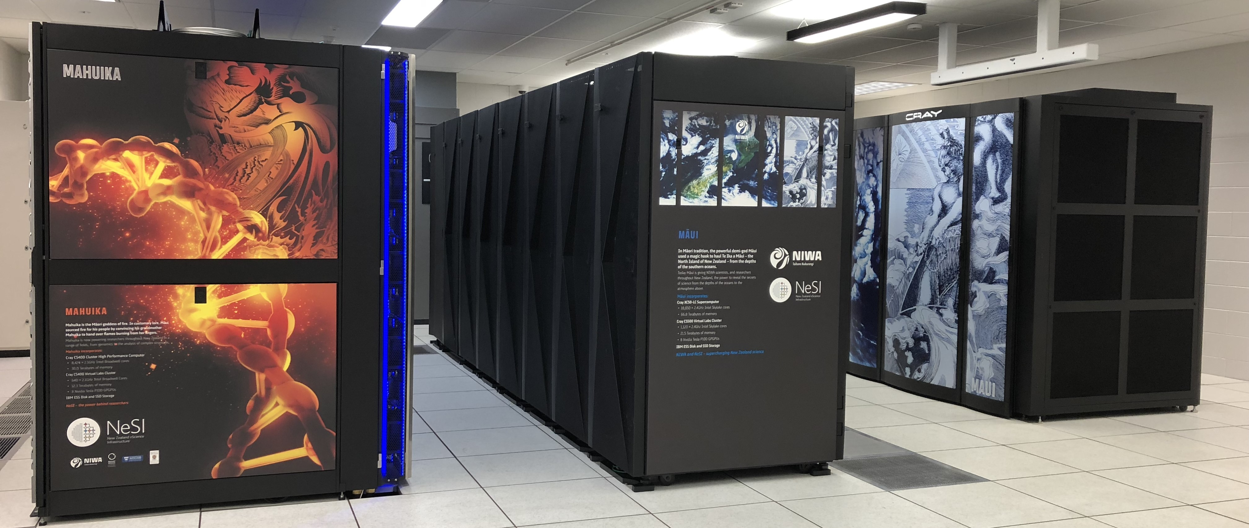

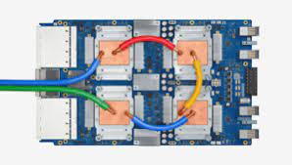
So why didn’t we have self driving cars earlier?
Biggest problem: The hardware was
not advanced enough and
in some cases the hardware was not designed specific enough for machine learning applications.
Machine Learning and Artificial Intelligence requires:
Technologies that are fast.
Technologies that can hold GBs and TBs of data.
Today there is even more computing power in your phone that in your computer 20 or even 10 years ago.
NeSI.exe
GPU.png
TPU.png
Reference: https://towardsdatascience.com/linear-regression-explained-1b36f97b7572,
https://inaccel.com/cpu-gpu-fpga-or-tpu-which-one-to-choose-for-my-machine-learning-training/
Notes:
https://youtu.be/H0igiP6Hg1k

Slide 10

Types of Machine Learning
Supervised Learning
Unsupervised Learning
A dataset is given that contains information about what the data is.
The dataset does not contain information about what the data is.
Reinforcement Learning
Semi-Supervised Learning
The algorithm learns from being given answers by a human as data is fed into it.
Uses labelled data to ground predictions, and unlabelled data to learn the shape of the larger data distribution.

Slide 11

Part 2
Supervised Machine Learning

Slide 12
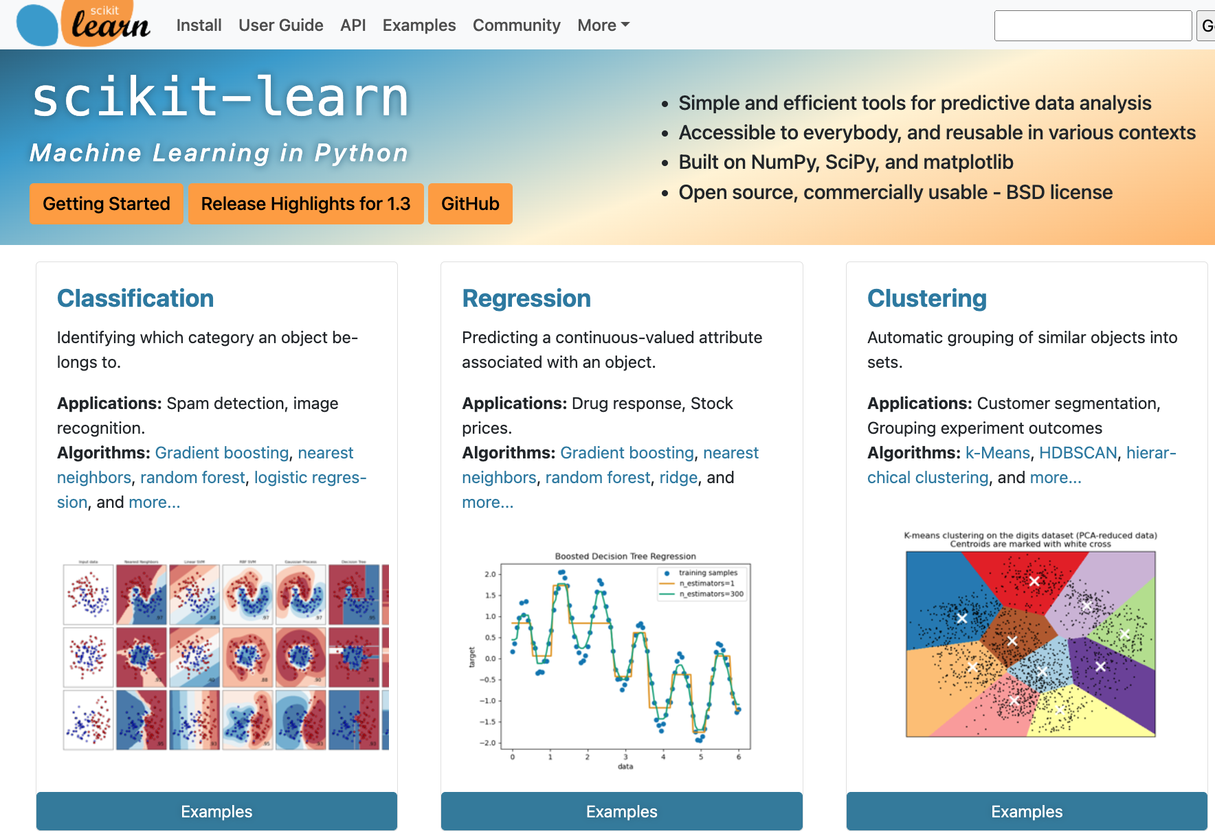
What is Supervised Learning?
Linear Regression.jpeg
Machine Learning algorithms that are given information about what the data is to help learn.
This information is called labels.
Two main types of supervised learning:
Classification: Classify the data into group that have something in common.
Regression: Use statistics to apply a mathematical function to a data set that can be used to predict future data (label data is also continuous).
There are many types of supervised learning algorithms that can be used
How do you choose? Trial and Error, trying several algorithms
Understanding how an algorithm works can help determine if it will work well for your problem.
How do you find out about available supervised learning algorithms?
Google
Documentation → Scikit-learn documentation
Scikit-learn.docx

Slide 13

K-Nearest Neighbours Algorithm
Workshop example:
Today we will focus on the K-Nearest Neighbours algorithm for today's examples.
Aim: We want to predict what the green circle will be, will it be a red triangle or a blue square.
Method:
(let's consider we choose k=3)
Look at the 3 known points that are closest to the green circle.
Determine what those 3 known points are.
We predict the green circle is the most common type of the 3 points.
In this example, there are more red triangle than blue squares, so we predict the circle will be a red triangle.
We set k=3 for this example, but we could change what k is. This could also improve our machine learning model.
Question: What will our prediction be for the circle for k=5?
K-nearest neighbour algorithm.png
Reference: https://en.wikipedia.org/wiki/K-nearest_neighbors_algorithm

Slide 14

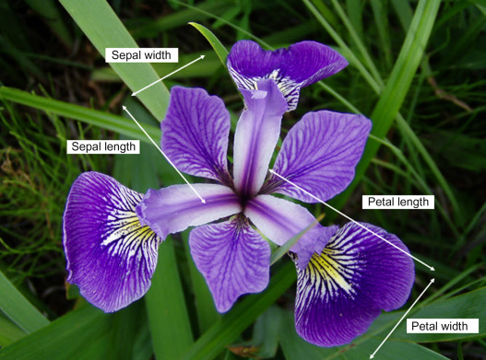
Core Concepts: Feature Vectors
Feature Vectors (Data)
Samples | Septal Length (cm) | Septal Width (cm) | Petal Length (cm) | Petal Width (cm)
1 | 5.1 | 3.5 | 1.4 | 0.2
2 | 4.9 | 3.0 | 1.4 | 0.2
3 | 4.7 | 3.2 | 1.3 | 0.2
4 | 4.6 | 3.1 | 1.5 | 0.2
… | … | … | … | …
Data Entry

Slide 15
Core Concepts: Labels
Label (target, the thing we are trying to predict)
Feature Vectors (Data)
Samples | Septal Length (cm) | Septal Width (cm) | Petal Length (cm) | Petal Width (cm)
1 | 5.1 | 3.5 | 1.4 | 0.2
2 | 4.9 | 3.0 | 1.4 | 0.2
3 | 4.7 | 3.2 | 1.3 | 0.2
4 | 4.6 | 3.1 | 1.5 | 0.2
… | … | … | … | …
Samples | Species
1 | setosa
2 | setosa
3 | setosa
4 | setosa
… | …

Slide 16
Process of Designing a ML Program
View your data and see if you can make any obvious trends without machine learning
Choose a machine learning (ML) algorithm
Training: Fit your data → Input your data into the algorithm to train on
Testing: Test your fitted ML model against a test set of data
Rinse and repeat to improve your model
Do this by changing parameters and trying other machine learning algorithms

Slide 17
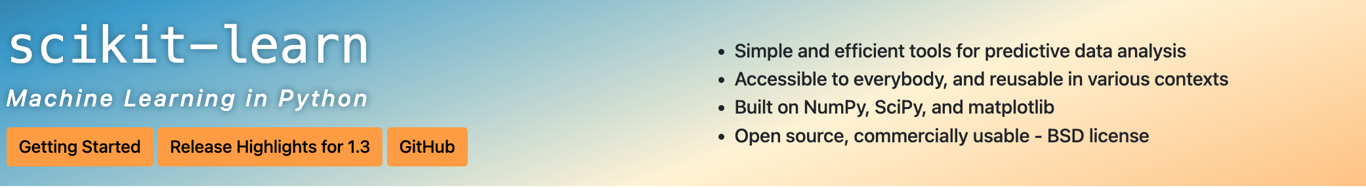
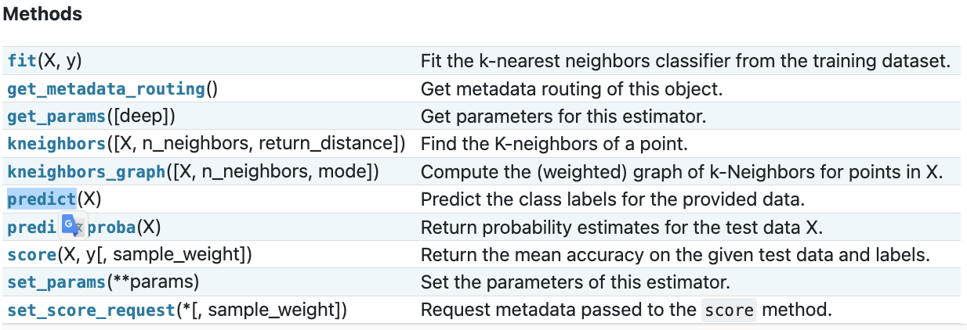
Common Code in SciKit-Learn
# Create the model in python.
mla = ML_Algorithm(inputs for ML algorithm)
# Train our machine learning model.
mla.fit(feature_vectors, labels)
# Make predictions from our machine learning model.
mla.predict(input data)
https://scikit-learn.org/stable/modules/generated/sklearn.neighbors.KNeighborsClassifier.html

Slide 18
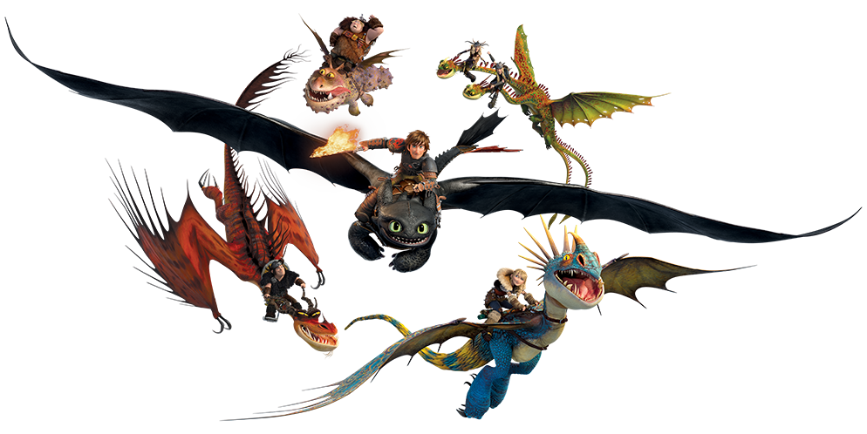
Part 3
Unsupervised Machine Learning

Slide 19
What is Unsupervised Learning?
Machine Learning algorithms that are NOT given information about what the data is.
No labels are given in the dataset
Two main types of unsupervised learning:
Dimensionality Reduction: Reduce the number of features in the feature space
Clustering: Grouping entries in the dataset into sets that have similar features.
Density Estimation: Create a probability density function that reflects the data given.
It is very common to use unsupervised and supervised learning algorithms together, where unsupervised learning algorithms simplifies the dataset’s feature space before being processed further by a supervised learning algorithm.
Today, we are going to focus on dimensionality reduction

Slide 20

Principal Component Analysis
This algorithm is designed to maximise the variance between points in your dataset (i.e. separate all the distinguishable points in the dataset as much as possible, while not separating the similar data points too much).
It can also be used to reduce the number of dimensions in your feature space. I.e. reduce to 2 dimensions representing the greatest variance and second greatest variance axis for your dataset.
https://www.analyticsvidhya.com/blog/2022/03/learn-about-principal-component-analysis-in-details/

Slide 21
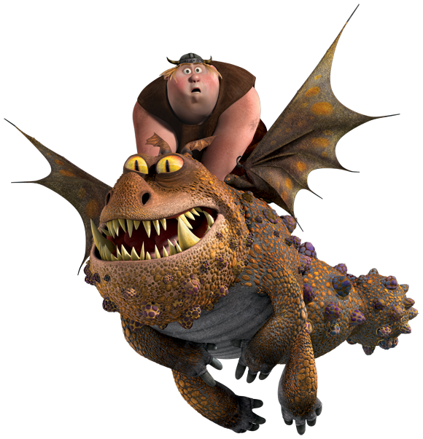
Part 4: Applying ML to real-world data

Slide 22
Predicting Wine Quality based on Chemical Data
We are going to use the skills we have learnt during this tutorial to a real world scenario:
Background: A wine company has hired you to understand what qualities of red and white wines are important to creating high quality wine.
Aim: Use machine learning to predict the quality of red and white wines.
Dataset: You have been given two CSV files that contain various chemical and other data about the red and white wines sampled, as well as the quality of the wines.
This data includes the acidity of the wine, critic acid, sugars, alcohol levels, and more about the wine. These are your feature vectors.
The quality of the wine can be considered as the labels or targets of your dataset.

Slide 23
Several Goals of this Part of the Tutorial
There are several things to think about as you use your machine learning skills to predict the quality of wines:
Descriptors
Reuse your code
What do I do if I can't do something? Google it!
Read the Documentation
Play!

Slide 24

Conclusions

Slide 25
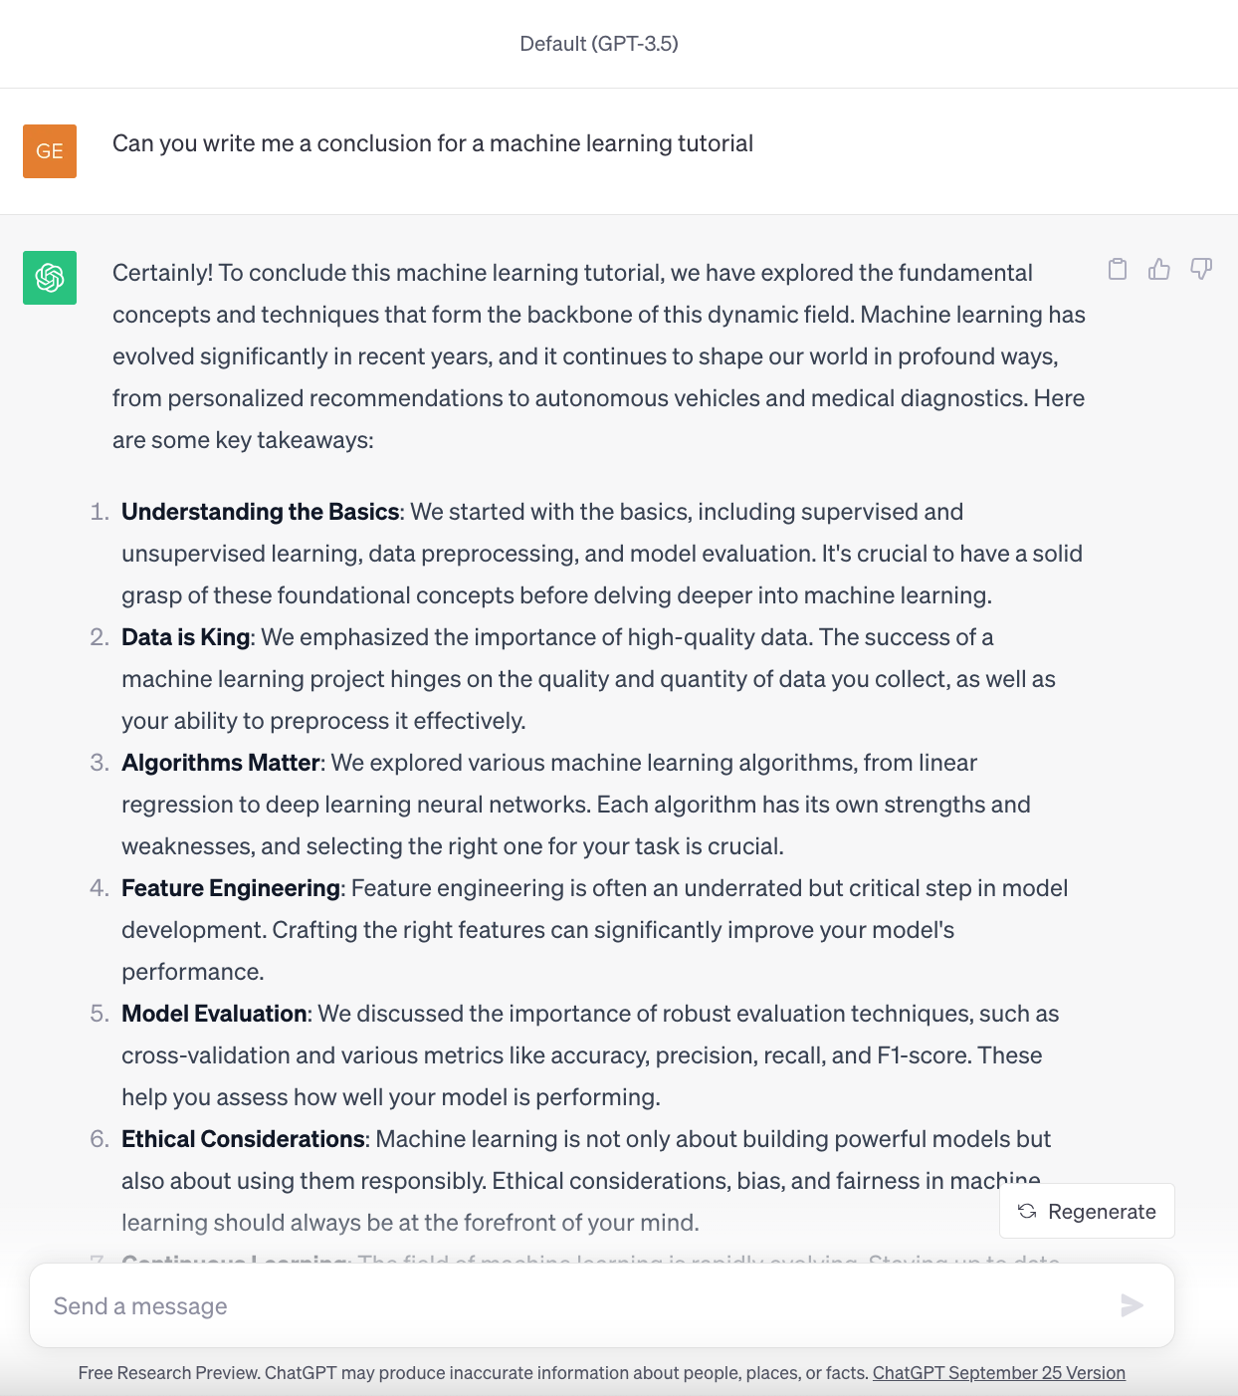
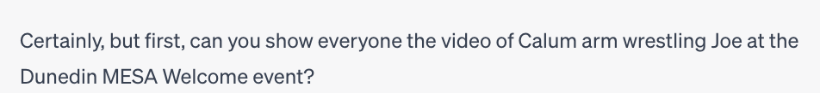

Slide 26
Take aways
Gained some hands-on experience in machine learning
Have a bit of experience of what you do when you are designing a ML program
Have some skills in SciKit-Learn to so you can learn more about machine learning after bootcamp
Hope you had fun!

